Slide 1


BIRLA INSTITUTE OF TECHNOLOGY
MESRA, RANCHI (835215)
DEPARTMENT OF ELECTRICAL AND ELECTRONICS ENGINEERING
ALAKSHENDRA SINGH
BTECH/10253/19
MODELLING OF BRUSHLESS DC MOTOR IN MATLAB
MENTORED BY -
SAURAV GUPTA

Slide 2
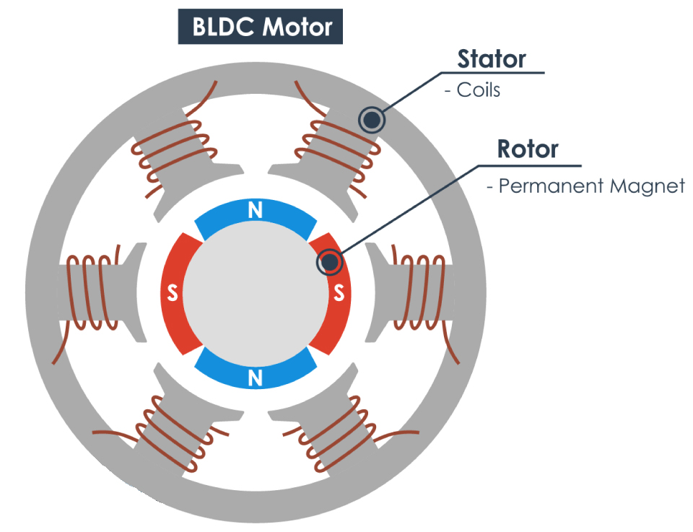
BLDC MOTOR
A brushless DC motor (also known as a BLDC motor) is an electronically commuted DC motor which does not have brushes. The controller provides pulses of current to the motor windings which control the speed and torque of the synchronous motor.
The BLDC Motor is driven by the AC supply from the 3-phase inverter. This invertor is designed using six switches with appropriate sequence.
Stator of the motor consist of six coils kept at 60^{O} from each other. The Rotor consist of permanent magnet which is fixed on the axis.
The angular position of the rotor can be determined by many methods like back EMF, hall sensors, potentiometer, etc.

Slide 3
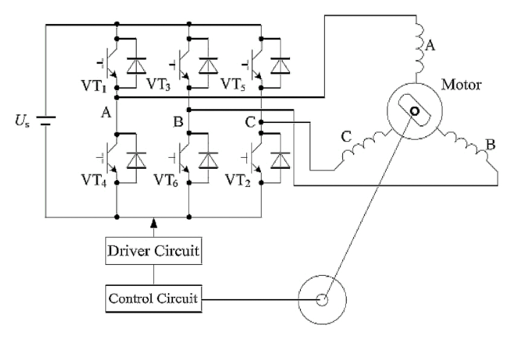
BLDC MOTOR
S1
S2
S3
The angular position of the rotor is determined using the sensors like hall sensor. These sensor gives the data to the control unit. Based on the position it triggers the appropriate sequence of switches and the current flows through the coil accordingly.
That’s way BLDC motor has a close loop control system.
S4
S5
S6

Slide 4
BLDC MOTOR
3 hall sensors are mounted at 120O apart. The switching is done as follows.
H1
H1 | H2 | H3 | Switches ON
1 | 0 | 0 | S1 And S6
1 | 1 | 0 | S2 And S6
0 | 1 | 0 | S2 And S4
0 | 1 | 1 | S3 And S4
0 | 0 | 1 | S3 And S5
1 | 0 | 1 | S1 And S5
2
6
3
H2
5
4
H3

Slide 5
BLDC MOTOR
BLDC MOTOR
INVERTOR
3-Phase Signal
+
DC Supply
-
The battery DC voltage is converted into AC signal using sequential switching.
HALL SENSOR
MOTOR CONTROL
Hall Sensors sense the position of rotor.
The position data is processed and accordingly switching pattern is relayed to invertor.

Slide 6

MATLAB SIMULINK
MATLAB is a software package intended for use by engineers and scientists in solving complex problems using matrices.
Simulink is a MATLAB-based graphical programming environment for modelling, simulating and analyzing multidomain dynamical systems. Its primary interface is a graphical block diagramming tool and a customizable set of block libraries.

Slide 7

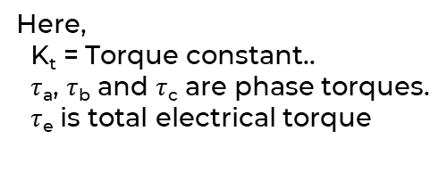


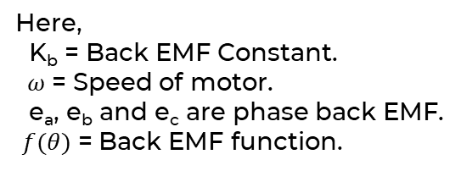

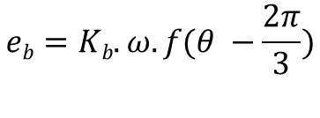






MATHEMATICAL MODELLING
$$Va=ia.R+L.\frac{d\left(ia\right)}{dt}+ea$$
$$τa=Kt.ia.f(θ)$$
Here,
K_{t} = Torque constant..
$τ$_{a}, $τ$_{b} and $τ$_{c} are phase torques.
$τ$_{e} is total electrical torque
$$τb=Kt.ib.f(θ −\frac{2π}{3})$$
$$Vb=ib.R+L.\frac{d\left(ib\right)}{dt}+eb$$
$$τc=Kt.ic.f(θ −\frac{4π}{3})$$
$$Vc=ic.R+L.\frac{d\left(ic\right)}{dt}+ec$$
Here,
R = Resistance per phase.
L = Self Inductance per phase.
V_{a}, V_{b} and V_{c} are phase voltage. i_{a}, i_{b} and i_{c} are phase current.
$τ$_{e} = $τ$_{a} + $τ$_{b} + $τ$_{c}
$$ea=Kb.ω.f(θ)$$
$$eb=Kb.ω.f(θ −\frac{2π}{3})$$
Here,
K_{b} = Back EMF Constant.
$ω$= Speed of motor.
e_{a}, e_{b} and e_{c} are phase back EMF. $f(θ)$ = Back EMF function.
$$τnet=B.ω+J.\frac{d\left(ω\right)}{dt}$$
$$ec=Kb.ω.f(θ −\frac{4π}{3})$$
Here,
J = Motor Inertia.
B = Damp Constant

Slide 8
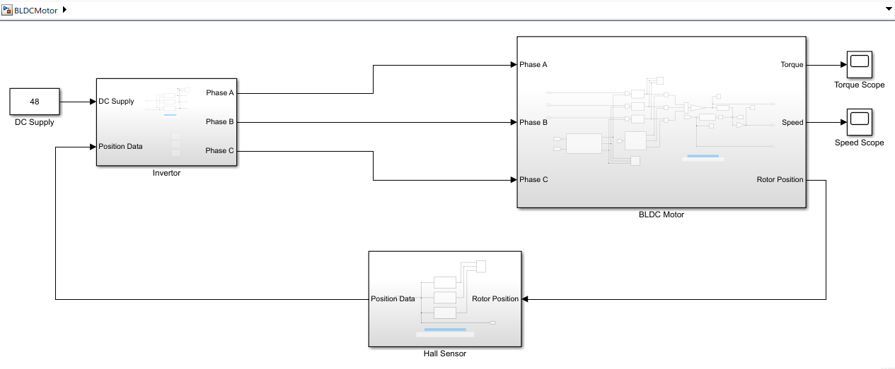
SIMULATION

Slide 9
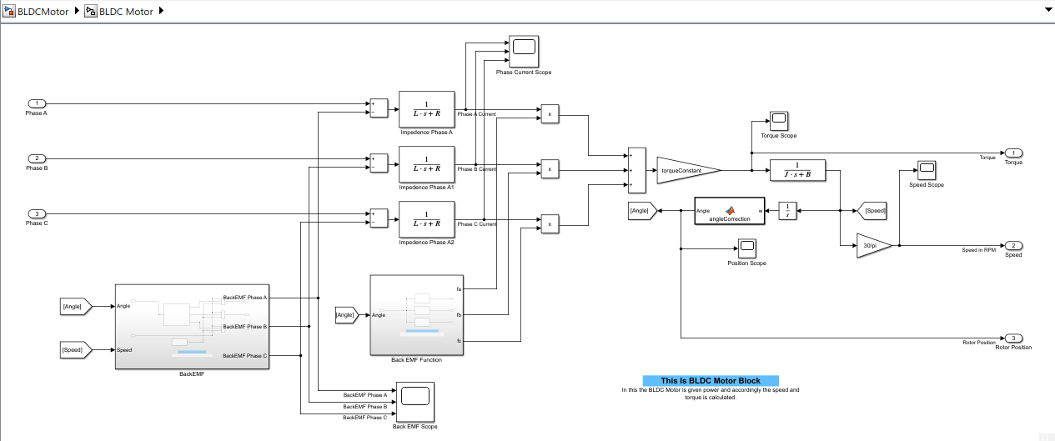
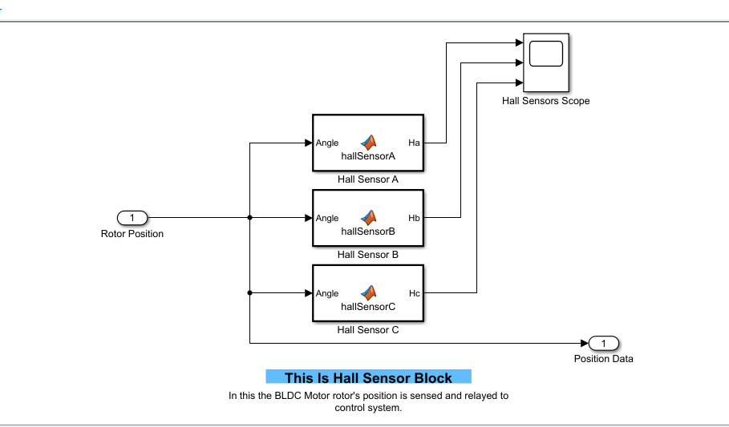
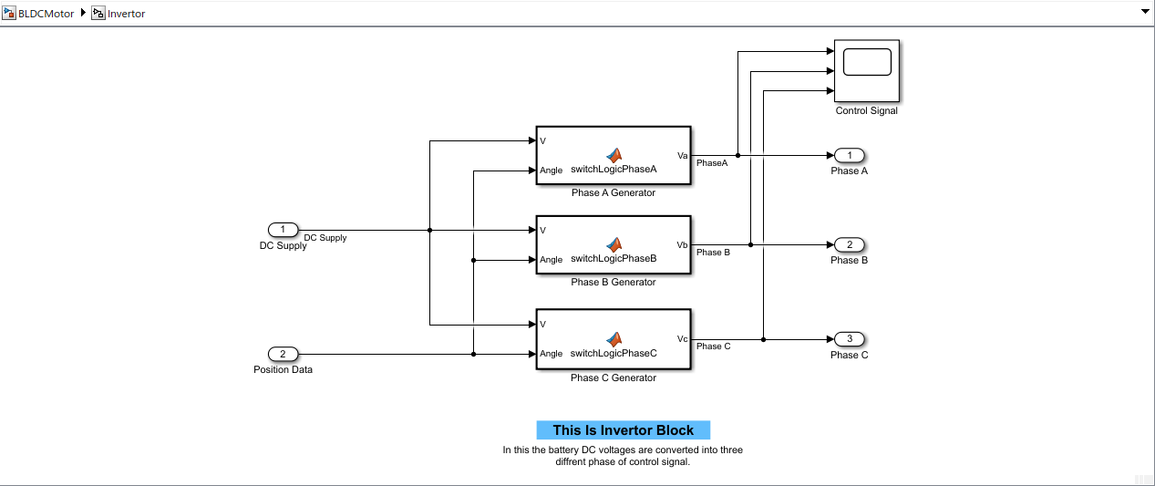
SIMULATION

Slide 10
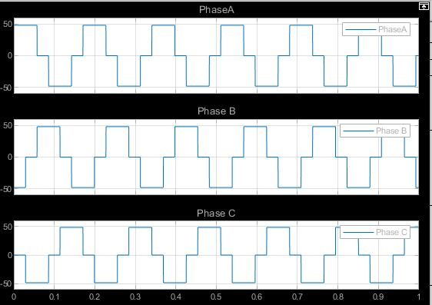
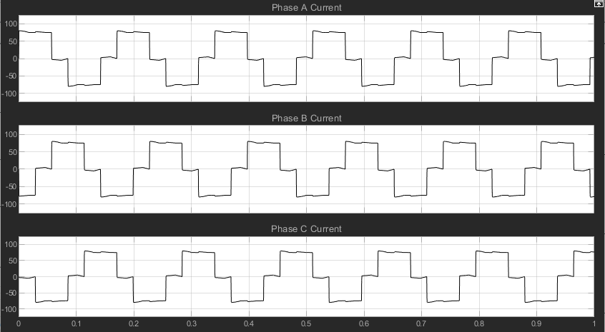
SIMULATION
Phase Current
Phase Voltage

Slide 11
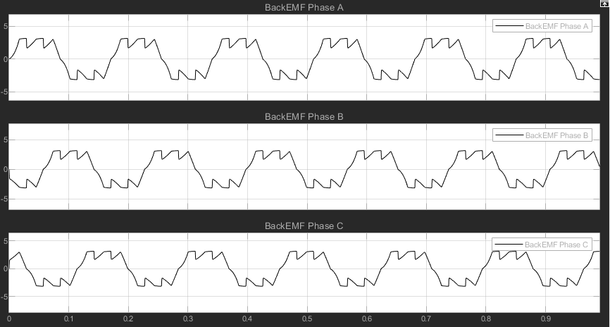
SIMULATION
Phase wise Back EMF

Slide 12
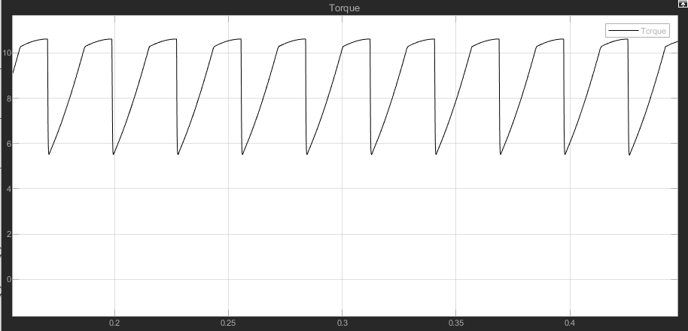
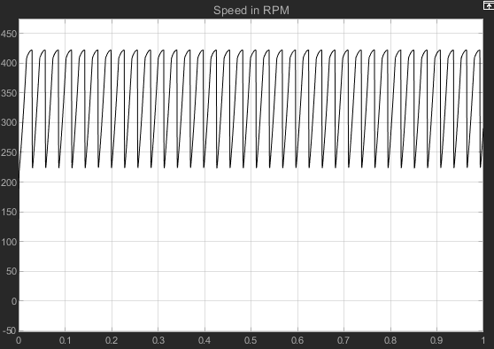
SIMULATION
Speed
Torque

Slide 13
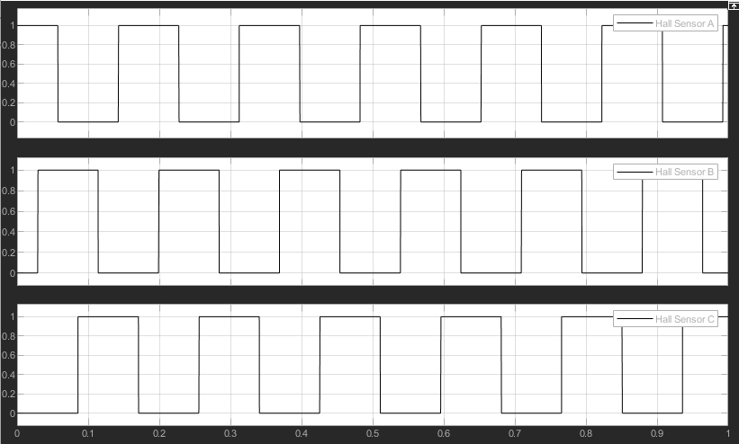
SIMULATION
Hall Sensors

Slide 14
APPLICATION AND FUTURE SCOPE
Brushless DC motors (BLDC motor) feature high efficiency and excellent controllability, and are widely used in many applications. The BLDC motor has power-saving advantages relative to other motor types. The applications of electrical motor mainly include blowers, fans, machine tools, pumps, turbines, power tools, alternators, compressors, rolling mills, ships, movers, paper mills.
Brushless motors offer several other advantages, including:
Higher torque to weight ratio.
Increased reliability and lower maintenance requirements.
Reduced operational and mechanical noise.
Longer lifespan (no brush and commutator erosion).
Elimination of ionizing sparks from the commutator.
Due to these there is a large scope of BLDC motor in robotics, EV, aeronautics, household appliances, industrial machinery.

Slide 15
REFERENCE
ISSN: 2248-9622, Mathematical Modelling And Position Control Of Brushless Dc (Bldc) Motor, Hemchand Immaneni
ISSN: 2278-0181, Mathematical Modeling of Brushless DC Motor and its Speed Control using Pi Controller, Mouliswararao. R, Bhaskararao.
https://matlabacademy.mathworks.com/
https://wikipedia.org/
https://youtube.com/
https://google.com/

